Slide 1

Flaunt Website Architecture Type: Application Architecture View: Logical View Style: Layered Architecture Pattern
USERS
DELIVERY CHANNELS
CORE BUSINESS PROCESSES
DATA AND INFORMATION
TECHNOLOGY ENABLERS
Account Management
Third Party Payment Gateway
Customer Data
Browse Products
Purchase Management
Product Data
INTERNET
Data Base Management
Payment Gateway Vendors
Payment Data
Customer
Logistics Service Providers
Order Data
Third Party Logistics Vendors
Advertising Media

Slide 2
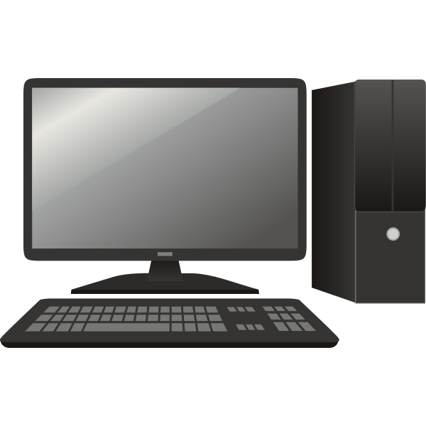





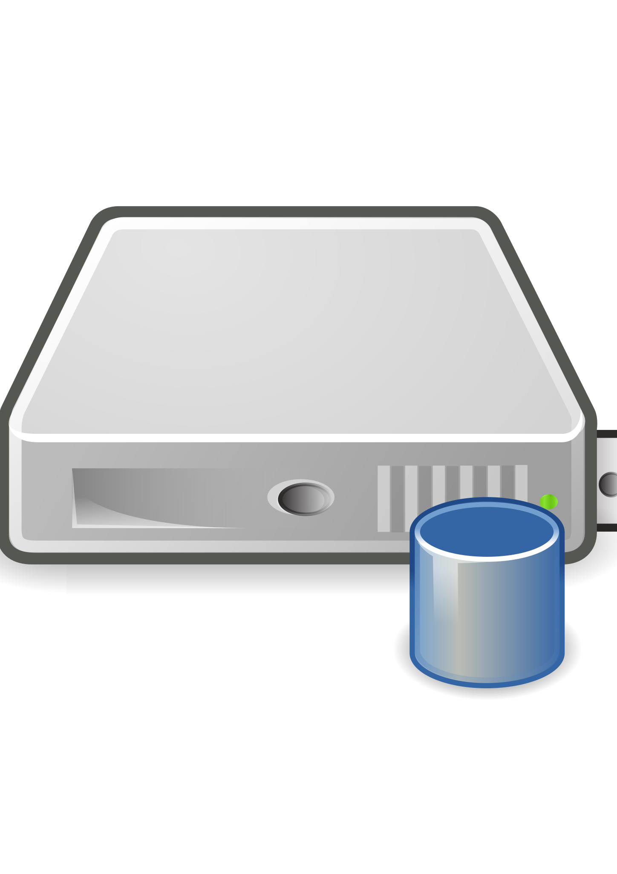

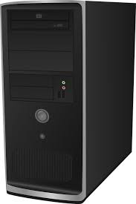
Flaunt Website
Architecture Type: Application Architecture View: Process View Style: Client-Server Architecture Pattern
Demilitarized Zone
Handling exception
Admin User
Authorizing users
Providing secure Configuration
Browser Authenticating users
Customers
Web server
App server
Database Server
Mobile Browser
Logistics and Payment gateway
Monitoring activity
Validating input
Encryption or hashing sensitive data

